Slide 1
Experience with Participatory Public Art in Daugavpils city
Landkreis Kassel, Germany
2022

Slide 2
Daugavpils is located in cross point of East Baltic

Slide 3
Our neighbours:
Lithuania – 25 km
Belarus – 35 km
Russia – 120 km
Daugavpils

Slide 4
Daugavpils – home city for people of more than 70 nationalities
Laipni lūdzam!
Sveiki atvykę!
Рэхим итегез безгэ!
Vasals Latgolā!
Добро пожаловать!
Vitam Was!
Вiтаємо!
Калi ласка!

Slide 5
POPULATION. EDUCATION. LABOUR POOL.
City population – 79 120
City agglomeration – 106 554
Latgale region – 252 682
Daugavpils labor pool – 40 000
Students – 5600/ Pupils - 8413
5 professional schools/ 3 colleges
Daugavpils University
Language skills:
Latvian/ Russian/ English/ Polish/ German/ Swedish/ French/ Spanish

Slide 6
Daugavpils City Municipality
Leaders Structure
City Council chairperson
City Council 1st vice-chairman
City Council vice-chairman
Administrative Structure
Executive director
Vice-Executive director
Vice-Executive director
10 departments and divisions
71 municipality institutions
11 companies
5 private companies
15 deputies elected for 4 years

Slide 7
Responsible for Art Events in Daugavpils city
Culture Department
Daugavpils Mark Rothko Art Centre
Daugavpils City Municipality Tourism Development and Information Agency
Daugavpils Engineering and Industrial Design Center “Engineering Arsenal”
Daugavpils Design and Art Secondary School «Saules skola»
Daugavpils City Kids and Youth Centre «Jaunība»
Culture Centres (Vienības nams, etc.)
NGOs

Slide 8
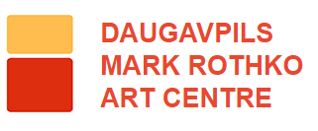
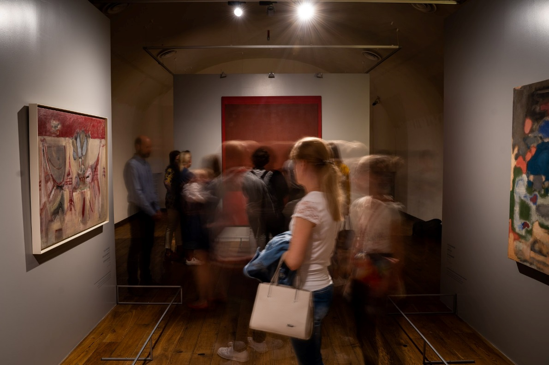
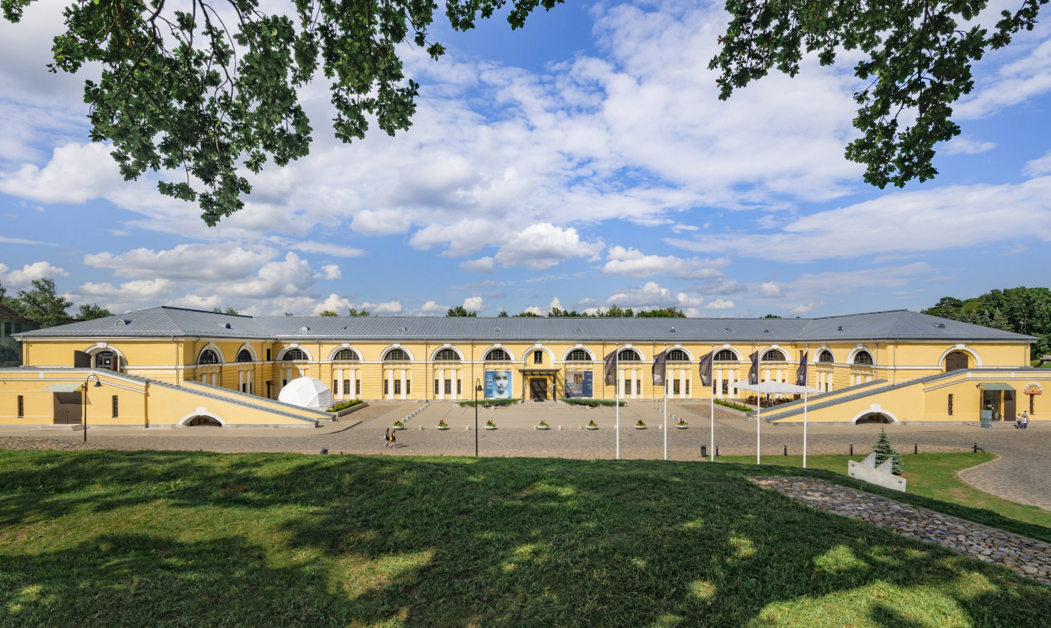
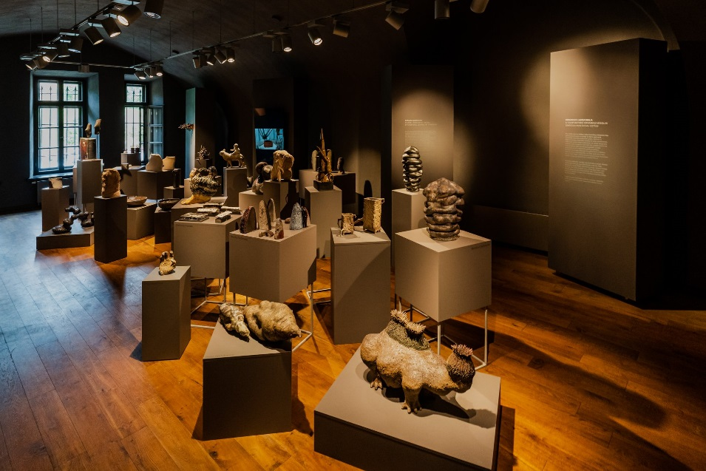
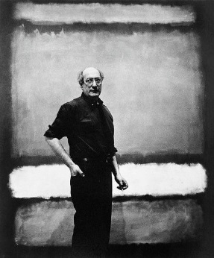
Mark Rothko –
world famous abstract expressionist

Slide 9
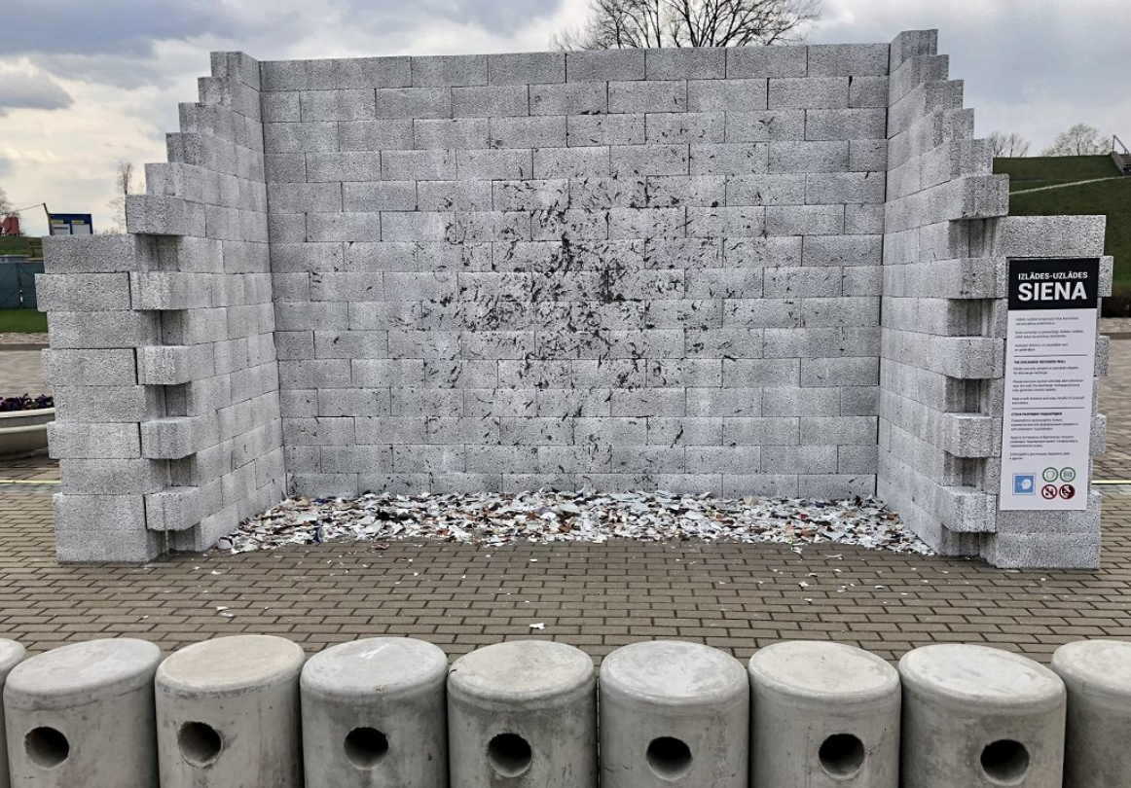
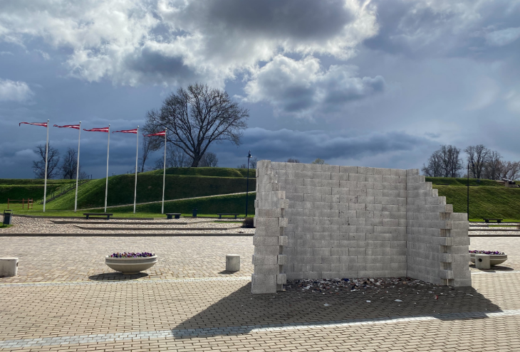
Participatory Public Art in Daugavpils
Example
THE DISCHARGE-RECHARGE WALL
The Daugavpils Mark Rothko Art Centre courtyard has been temporarily transformed with a Discharge-Recharge Wall – a custom-made site for an interactive self-performance open to anyone willing to join
Concerned for the mental state of its colleagues and the general public, the Rothko Centre team has prepared a targeted and controlled anger management tool – an interactive Discharge-Recharge Wall.
With this art site for interactive self-performance, the Rothko Centre celebrated its eighths birthday and heralded the Latvia Ceramics Biennale scheduled for the upcoming summer.
2021
https://www.youtube.com/watch?v=r5YeT2eBH6w
Smash against the wall chipped, unwanted, or downright irritating mugs, plates or other ceramic objects!

Slide 11
Feedback
Some comments on social media about the project
«I would have left this wall permanently!»
«I finally found where to use my hand made mugs that I don’t like!»
«We liked it – but had to buy plates at the supermarket specially to smash.»
«It was a great art event!!»
«Even people in ancient Egypt practiced this way of anger management, but it did not help to avoid wars and arguments. I think art needs to be about creating – not destroying!»
This project was nominated for Latvian award in culture «Kg kultūras» in category «Surprise»

Slide 12
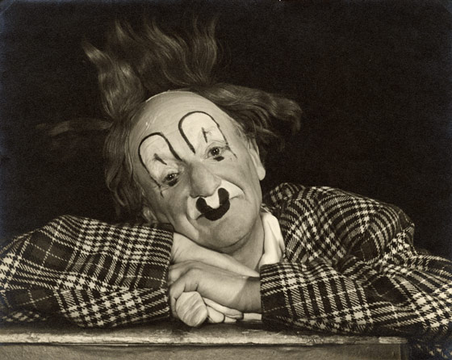
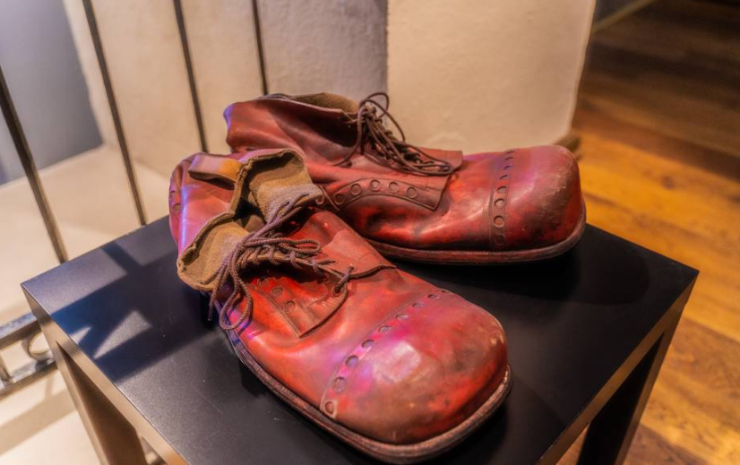
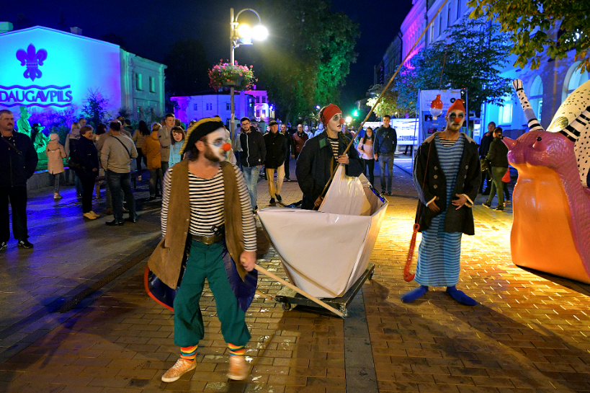
Participatory Public Art in Daugavpils
Example
Born in Daugavpils
INTERNATIONAL FESTIVAL OF STREET THEATRE AND CLOWNERY IN DAUGAVPILS (2019)
Nicolai Poliakoff
(1900-1974)
Granddaughter of Poliakoff presented to Daugavpils his clown shoes.
Coco the Clown, awarded with
the «Order of the British Empire» in 1959

Slide 13
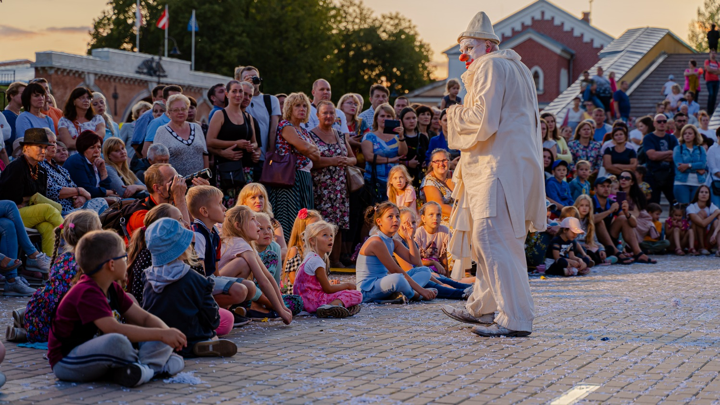
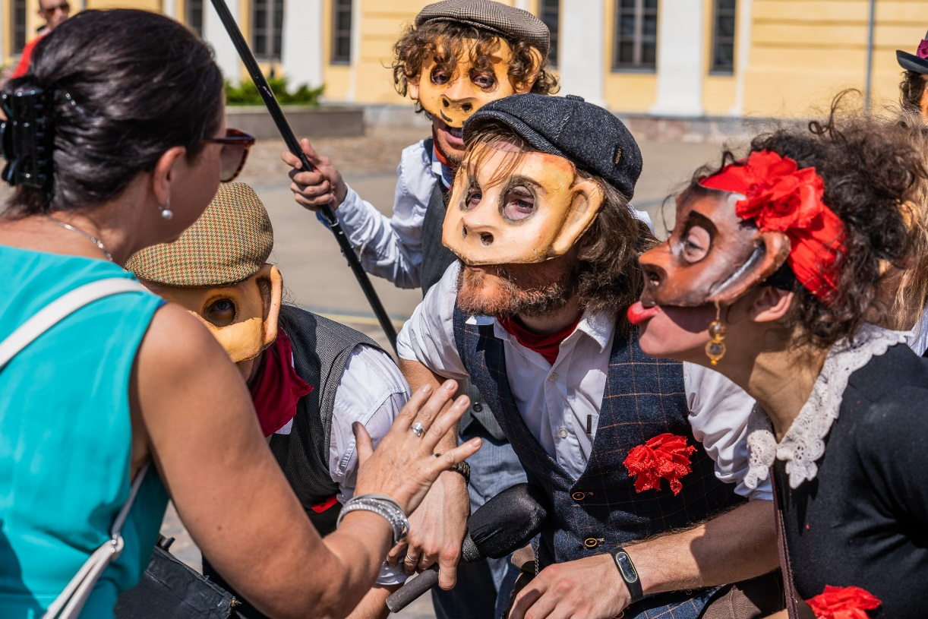
Participatory Public Art in Daugavpils
Example
INTERNATIONAL FESTIVAL OF STREET THEATRE AND CLOWNERY IN DAUGAVPILS
Interactive communication with people during the festival – everyone gets to feel included, this helps to feel connected and included in the society.

Slide 14
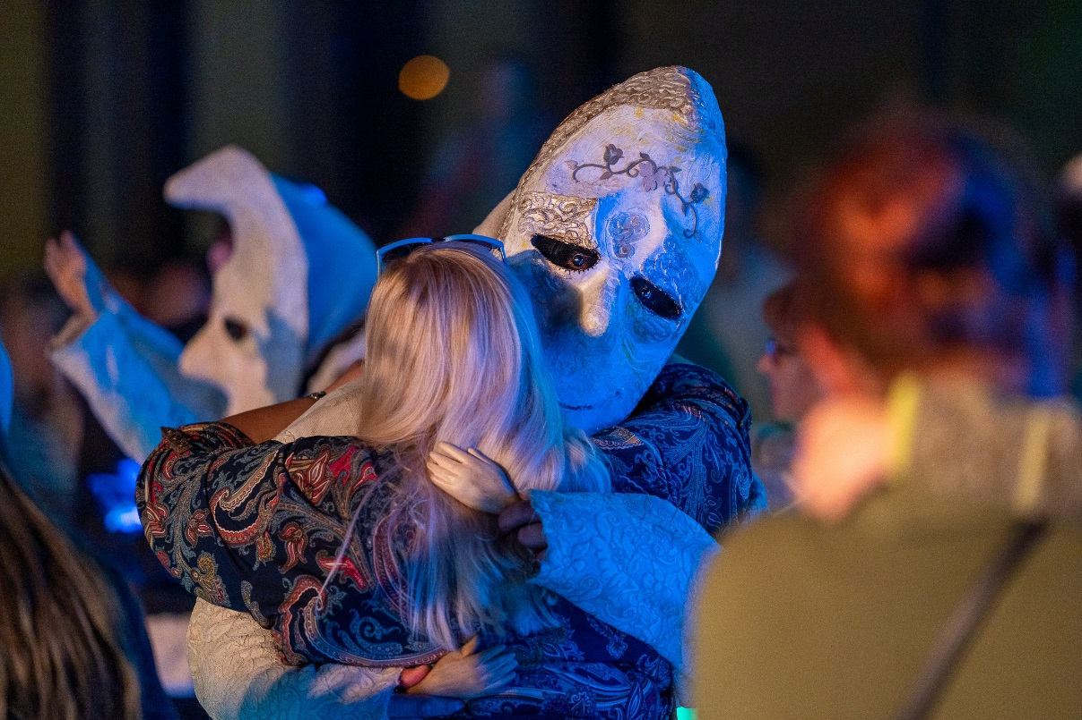
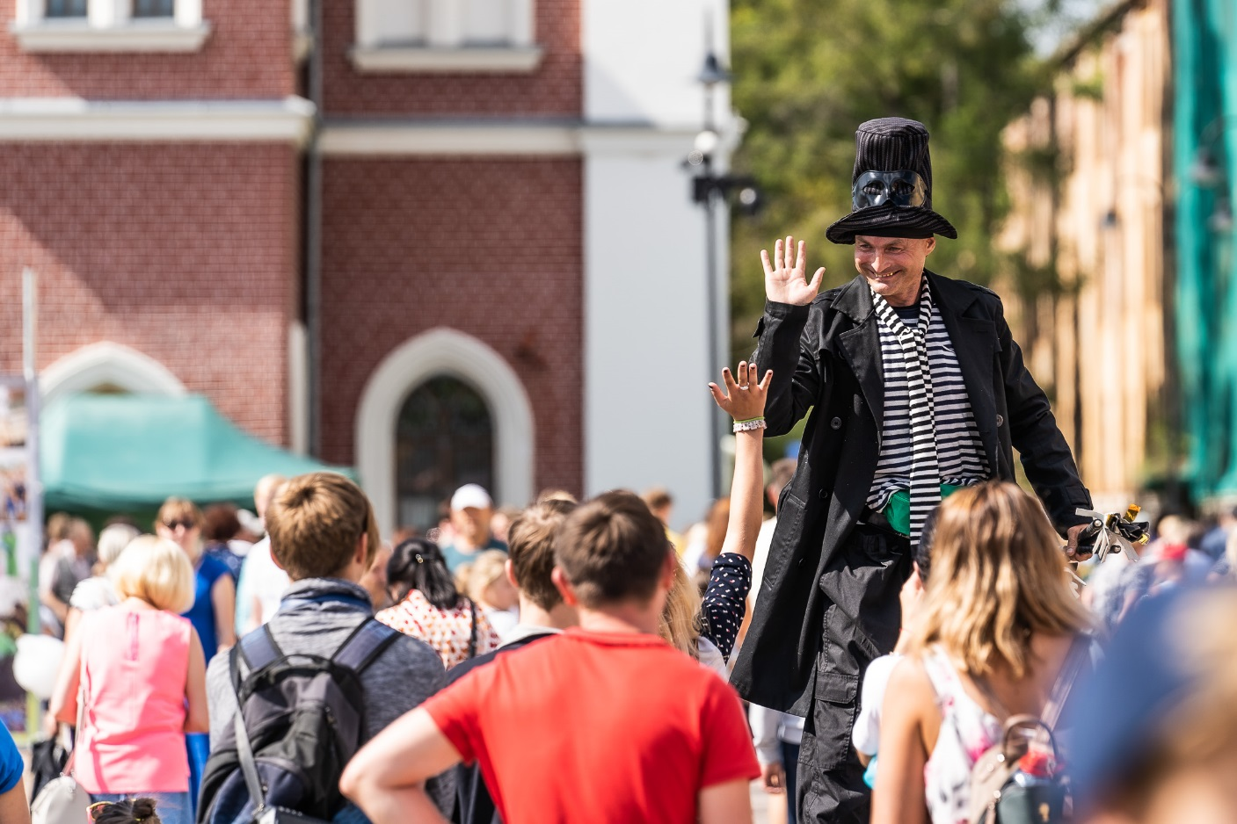
Participatory Public Art in Daugavpils
Example
INTERNATIONAL FESTIVAL OF STREET THEATRE AND CLOWNERY IN DAUGAVPILS
Only positive feedback from the people at the moment of festival. As it was street event, everybody was able to join – even just walking by.

Slide 15
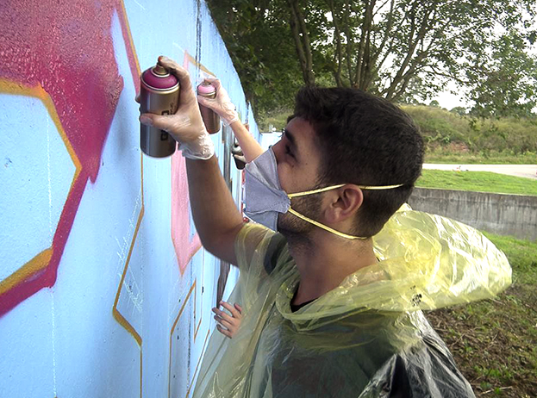
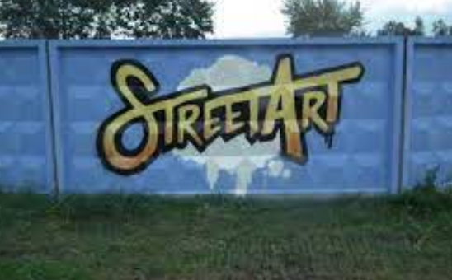
Participatory Public Art in Daugavpils
Example
NGO «Erfolg» organized graffiti event «LET'S BREAK STEREOTYPES – DRAW GRAFFITI»
Organized within ERASMUS+ project «STREET ART»
Youth from different European countries made graffiti art objects on walls on the streets of Daugavpils (city centre). Project is aimed to encourage openess and learn more about other countries. Each participant drew something that is important in their culture.

Slide 16
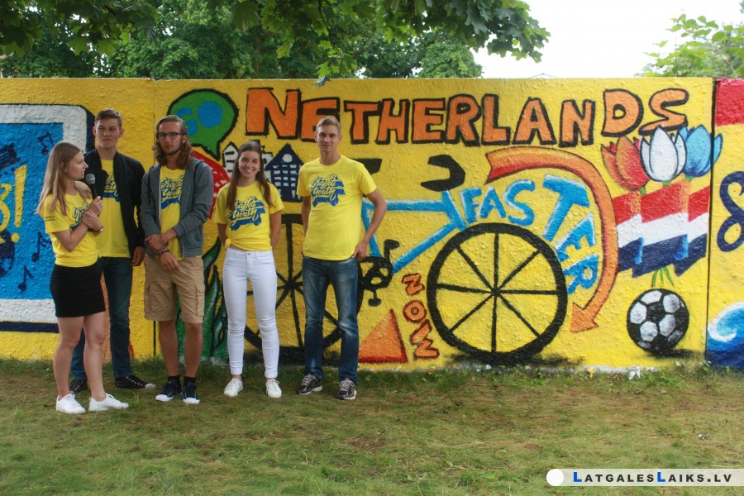
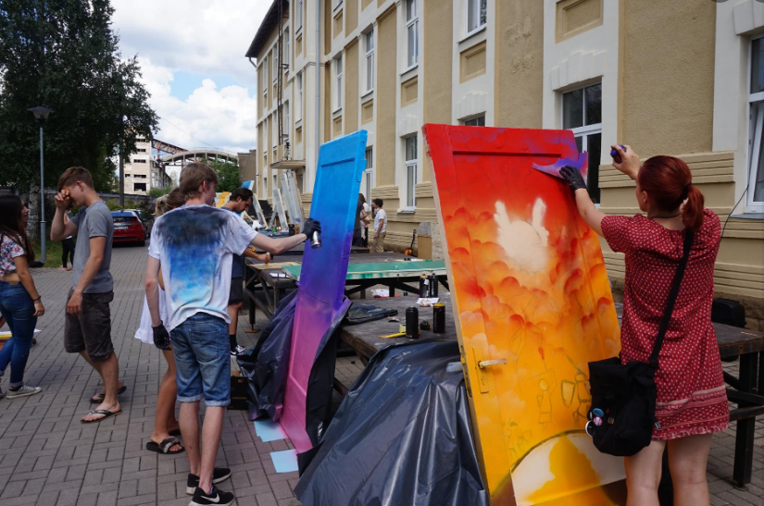
Participatory Public Art in Daugavpils
Example
NGO «Erfolg» organized graffiti event «LET'S BREAK STEREOTYPES – DRAW GRAFFITI»
Organized within ERASMUS+ project «STREET ART»
Graffiti and street art can be controversial, but can also be a medium for voices of social change, protest, or expressions of community desire.

Slide 17
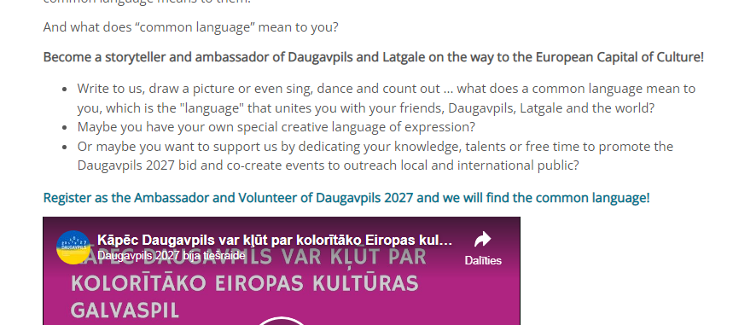
Participatory Public Art in Daugavpils
Example
Daugavpils was shortlisted in the competition for the title of European Capital of Culture 2027 in Latvia
Civil participation on a way to become the European Capital of Culture 2027
Everybody were invited to look for common language!!!

Slide 18
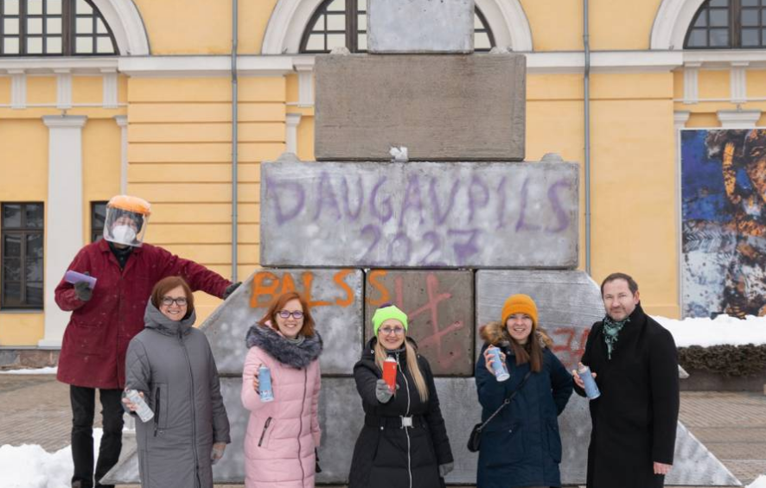
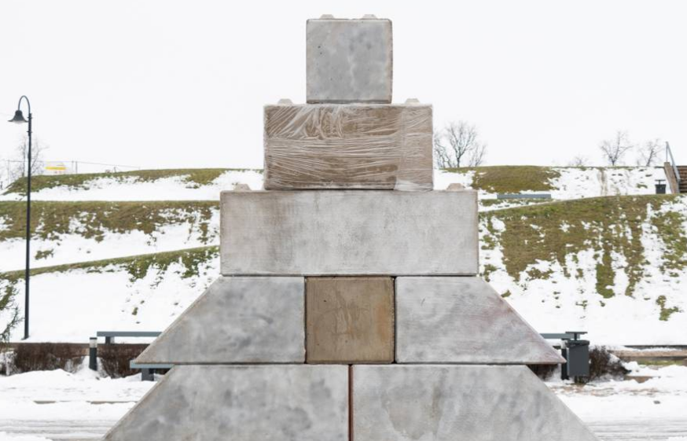
Participatory Public Art in Daugavpils
Example
Daugavpils was shortlisted in the competition for the title of European Capital of Culture 2027 in Latvia
Decorating of Concrete Tree
Everybody were invited to participate – to draw or right on this concrete «tree» what does it mean for them – common language?
https://fb.watch/ephb7HyShN/
It was 10 tonnes.

Slide 19
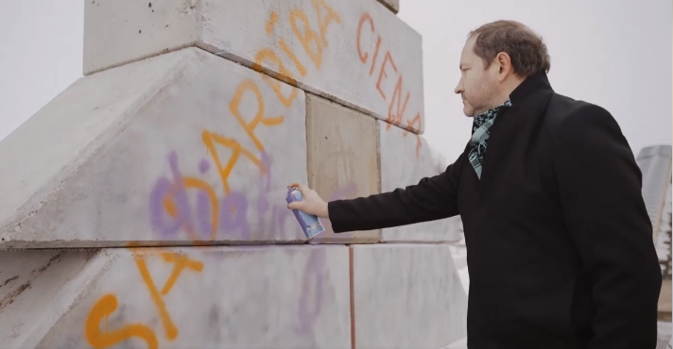
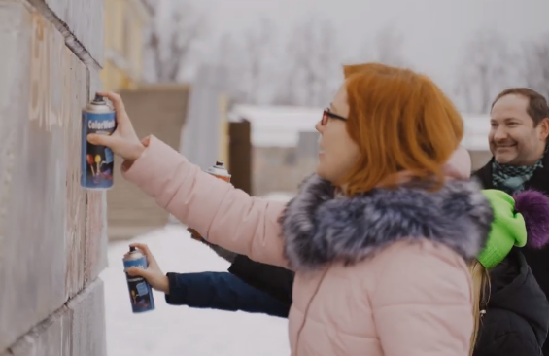
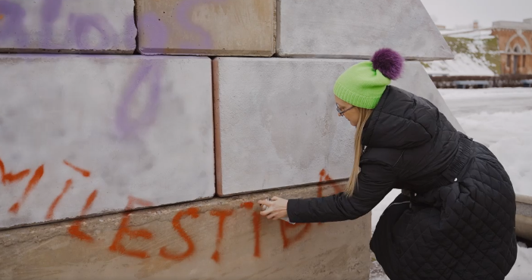
Participatory Public Art in Daugavpils
Example
Decorating of Concrete Tree
FEEDBACK – a lot of positive feedback.
At the same time there were people who did not appreciate this art object, especially at the beginning before it was decorated by locals (they said that its too dark, grey and depressing).
Also swear words were written on it – some locals complained.
Notes:
https://fb.watch/ephb7HyShN/

Slide 20
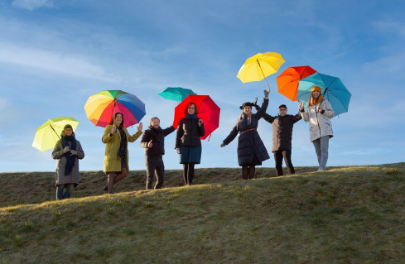
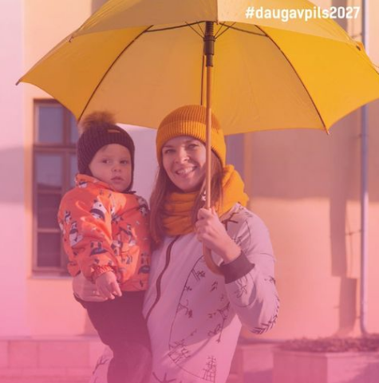
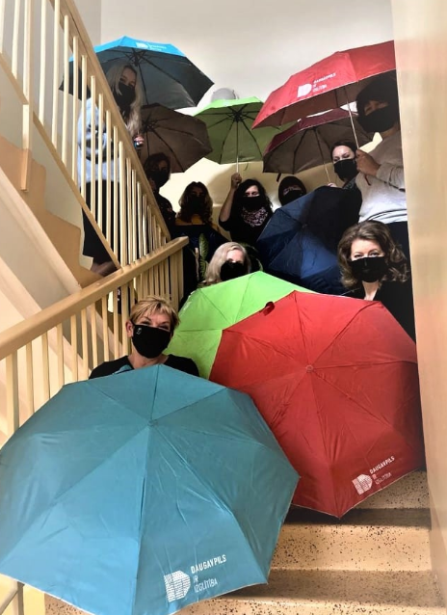
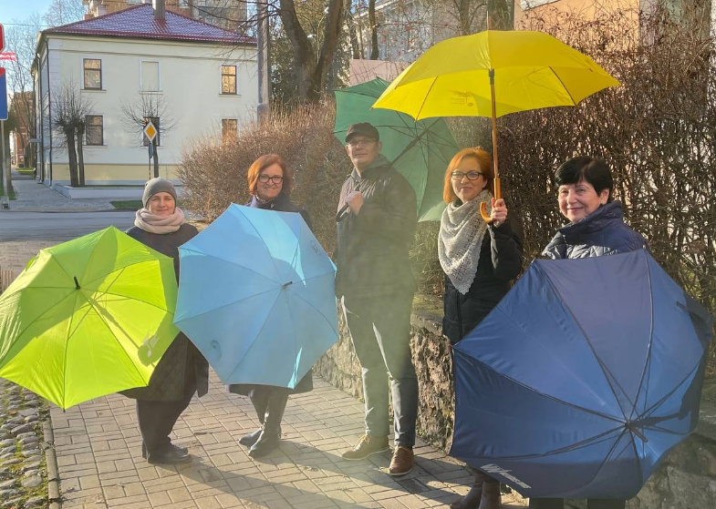
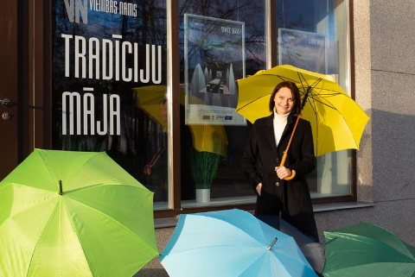
Participatory Public Art in Daugavpils
Example
Photography Art to Support Sphere of Culture During Pandemic

Slide 21
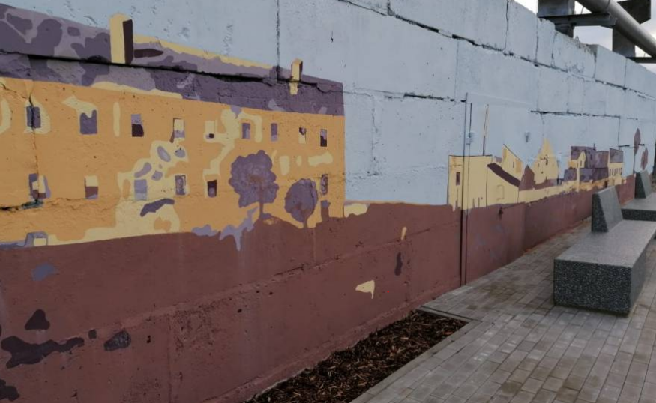
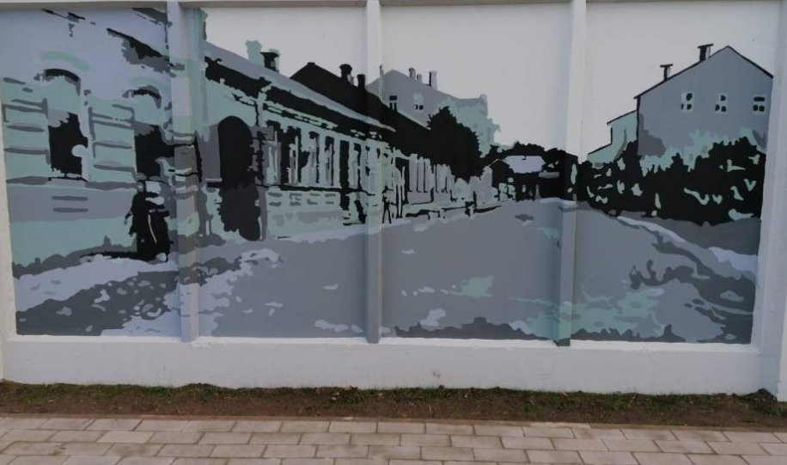
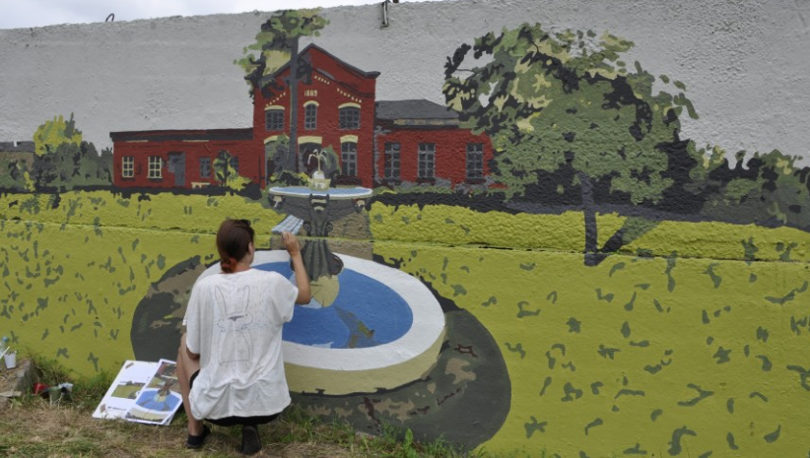
Participatory Public Art in Daugavpils
Example
Art at Bruģu Promanade
Daugavpils City Council finished construction project of a new promanade along the river.
Along the promanade there is a wall – local artists were invited to prupose what to draw on it – something that would represent history if this particular part of the city.
This way sense of belonging was encouraged.

Slide 22
Thank you for your attention!
Olga Tolmačova
Head of Office of International Cooperation and Investments,
Development Department of Daugavpils City Municipality
Olga.tolmacova@daugavpils.lv

